Slide 1
College Council
May 13, 2021

Slide 2
Reporting Committees

Slide 3
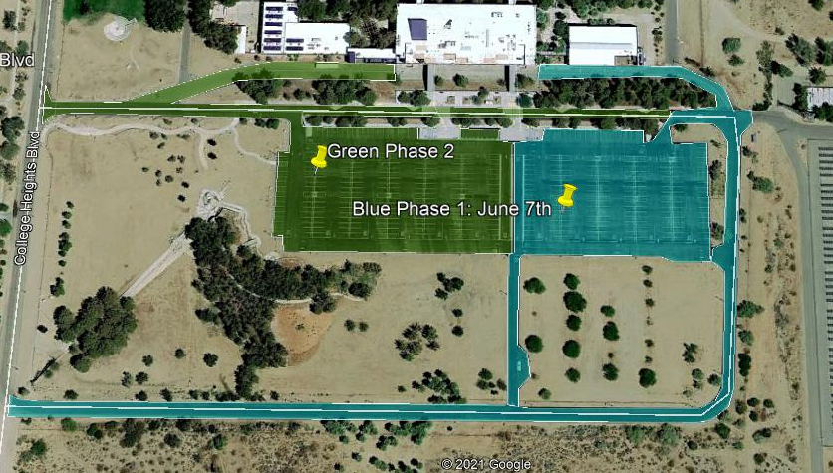
Facilities – Cody Pauxtis
Next meeting Fall 2021
ION Install:
IWV 70%
ESCC 0%, 18 & 19 May
Parking Lot Re-surfacing:
7 June – 16 July
7 – 21 June Phase one
21 June – 16 July Phase two and CDC

Slide 4
Safety & Security – Kevin King
KCCD Emergency Operations Plan
Communications through District
Step 1: Survey Due May 17th
Safety and Security Committee CFIT to address "Feel" of security across our campuses
Next Meeting: Fall 2021

Slide 5
Technology Resource Team (TRT) – Mike Campbell

Slide 6
Student Success Support Programs (SSSP) – Heather Ostash
Cross-functional Inquiry Team-​
Program 2.0-
​ Career Exploration connection programs
Looking at models at other colleges
Student communication- ​
Student Success Syllabus
Application to 1st week
Series of Communications
Modules for remainder of semester- Like Wellness Central
Ocelot Launch
Live Chat
21 Languages

Slide 7
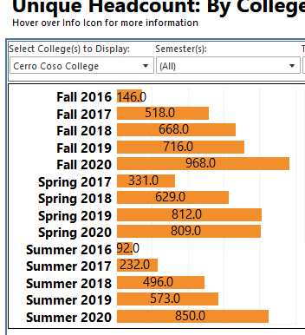
Incarcerated Students Education Program – Peter Fulks
CDCR has approved entry into facilities for summer and more for fall
Faculty are working on new modalities of teaching, again!
We agree and advocate for the staffing analysis for ISEP
Innovation and Re-entry Grant funds end, lets take a quick review of the impact:
Thousands of students lives changed, structural integration into school, national leader, translatable impacts, ~700 FTEs yearly, 100+ graduates this year

Slide 8
Discussion Items

Slide 9
Associated Committees

Slide 10
Budget Development – Lisa Couch
Budget Recommendation (attachment)
Defining how budget requests will be made in new software (training immediately after we return in the fall)
Refining Rubric (training immediately after we return in the fall)

Slide 11
District Wide Budget Development Committee – Lisa Couch
Revisions to Board Policy & Administrative Procedures related to the reserve
Subcommittee recommendations on how to allocate funds for district vs. District-wide costs.
Narrative being drafted that outlines proposed internal allocation model

Slide 12
Institutional Effectiveness Committee (IEC) – Corey Marvin
Not met. Next meeting at 3:00 pm today!

Slide 13
Professional Development Committee – Corey Marvin
Not met. Next meeting in the fall semester.

Slide 14
Accreditation – Corey Marvin
Not met. Next meeting in the fall semester.

Slide 15
The End

